Slide 1

Safeguarding Presentation
Governors Update

Slide 2

OBJECTIVES
Provide a basic overview of the Safeguarding Agenda for Schools and where Child Protection fits into it.
Explore your role of school governor and how that fits into this agenda.
Be clear about the main Legislation and Guidance underpinning safeguarding.
Provide you with the school context regarding Child Protection.

Slide 3
What is the relation between child protection and safeguarding?
Safeguarding means proactively seeking to involve the whole community in keeping children safe and promoting their welfare.
Child protection is the process of protecting individual children identified as either suffering, or at risk of suffering significant harm as a result of abuse or neglect.
Notes:
Need to be aware of the differences between Safeguarding & Child Protection as potentially you will be investigating a complaint which needs to be referred for consideration as a Child Protection allegation.

Slide 4
Anti Bullying Policies
Child Protection
Staff Conduct
Attendance
Safeguarding
Curriculum
E-Safety
Managing
Allegations
Against Staff
Behaviour
Management
Health and Safety
Building Design
Whistle blowing
Safe
Recruitment and Selection
Notes:
This list is not exhaustive but examples of what may be considered under the safeguarding umbrella.

Slide 5
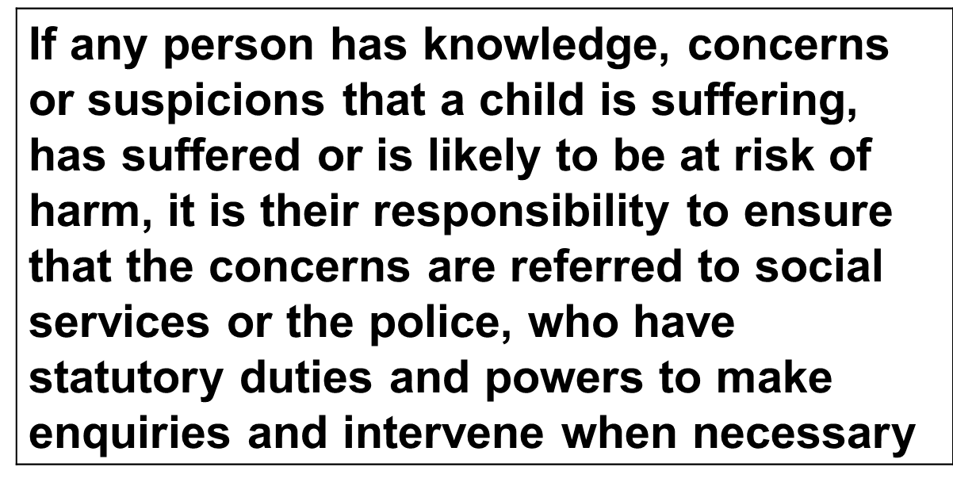
Duty To Refer
All Wales Child Protection Procedures 2008

Slide 6
Child Protection is a collective responsibility
  School Child Protection Policy
  Wales Safeguarding procedures
  Working Together Under the 2004 Act
  Keeping learners safe WG 158/2015
  Disciplinary and dismissal procedures for school staff WG 002/2013
  Safeguarding Children in Education: handling allegations of abuse against teachers and other staff WG 009/2014
  Records Management Toolkit for schools www.irms.org.uk
  Educational Records, school reports and the Common Transfer System – the keeping, disposal, disclosure and transfer of pupil information Circular No 18/2006

Slide 7
Legal Responsibilities under Section 175
“The governing body of a maintained school shall make arrangements for ensuring that their functions relating to the conduct of the school are exercised with a view to safeguarding and promoting the welfare of children who are pupils at the school”.
Governors should :
Ensure safe recruitment of staff
Ensure all staff and volunteers have Safeguarding/Child protection training at the appropriate level and kept up to date by refresher training
Give clear guidance to temporary staff and volunteers on the organisation’s arrangements for child protection and their responsibilities LEAFLET.
Ensure the school has an active and effective child protection policy and procedures
Make available to parents or carers on request
Ensure that any policies and procedures are reviewed at least annually
Ensure that school has a senior member of school staff is designated to take responsibility for child protection issues and has a deputy
Ensure the designated teacher receives appropriate training
Safeguarding to be an agenda item for GB meetings

Slide 8
Estyn Inspection – judging safeguarding
Causes for concern:
staff are unclear about their responsibilities
poor approaches to safe recruitment (e.g. missing references and DBS checks)
Inconsistent approaches to reporting child protection/safeguarding concerns
Not dealing with bullying effectively
Not developing awareness about online safety
Inadequate arrangements for pupils with medical conditions
Notes:
Please note these are themes from inspections and not specific to your individual school.
Should nay concerns have been identified please share at this point.

Slide 9
Estyn Inspection – what will they inspect?
Policies and procedures
Evidence from the self evaluation form
DBS records
Child protection training records
School security
Talk to pupils/voice of the child
Records of physical interventions
Notes:
This provides you the opportunity to explore any previous inspections, trends, themes or concerns you may need to share with the governing body.

Slide 10
Prevent
The Counter-Terrorism and Security Act 2015 includes a new duty on schools and colleges to “have due regard, in the exercise of their functions, to prevent people from being drawn into terrorism”
Respect and Resilience (196.2016) provides supplementary guidance, plus a self-assessment tool which will ensure that schools in Wales are able to meet the legal requirements of the Counter-Terrorism and Security Act 2015. The guidance is non-age specific, covering the Foundation Phase, primary and secondary stages and provides clear, practical advice.

Slide 11
Jade Harrison
Operational Manager - Strategic Improvement and Strategy
Lynda Gallagher
Team Manager – Education Safeguarding Team & Local Authority Designated Officer LADO
Matt Osbourne
Service Manager
Jo Bowman
Education Safeguarding Officer
Nikki Loukisas
Education Safeguarding Officer
Kate Willington
Education Safeguarding Officer
Alexis Morley
Education Safeguarding Officer
Harriet Mowbray
Business Support
Amy Powell
Education Safeguarding Officer

