Slide 1


Baden Powell Primary School
Curriculum
for
Wales
Aim high, Achieve more, Be happy

Slide 2
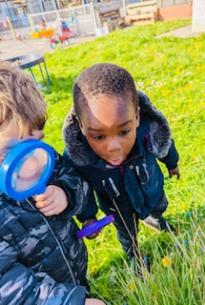
Our Curriculum Vision
To develop a high quality learning environment where all learners feel happy and safe, and achieve their full potential.
At Baden Powell, our aim is for all learners to be active, interested and increasingly independent.
We aim to provide a curriculum that is engaging and challenging, enabling learners to achieve their full potential.
Our goal is for our learners, staff and community to feel safe, be resilient and respectful, and well prepared for the future.
Values & Aims
Respect To respect ourselves and others, and the environment around us.
Achieve To work hard to and challenge ourselves in all we do.
Inclusive To treat everyone fairly and care for others.
Secure To make positive choices to keep ourselves safe, healthy and active.
Engaged To enjoy new experiences and activities.
Resilient To keep on trying and learn from our mistakes.
Raiser: to move to a higher position; lift up; elevate
Aim high, Achieve more, Be happy

Slide 3

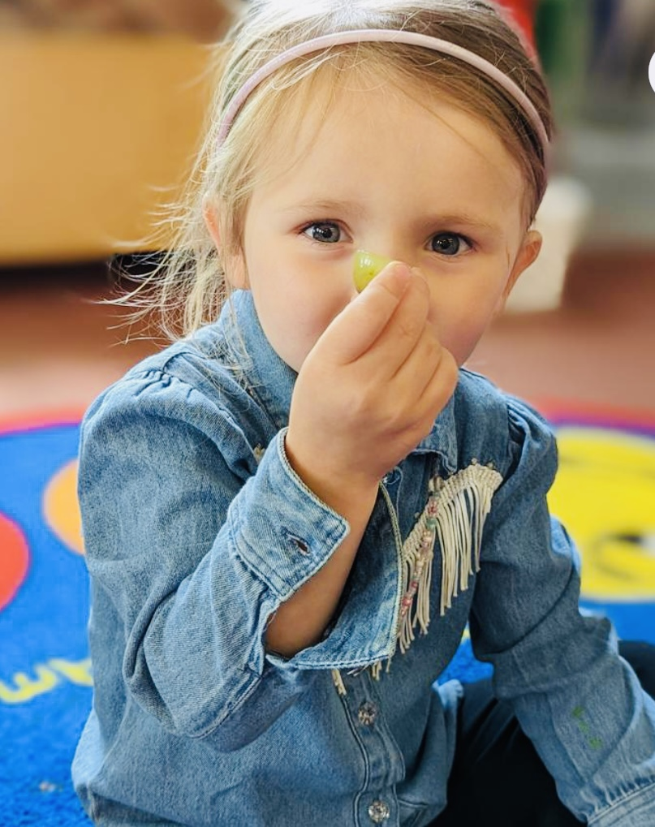
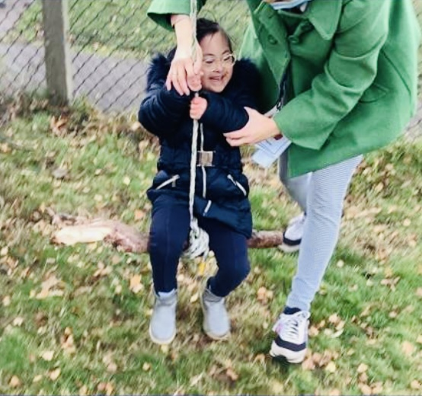
At Baden Powell Primary School, our curriculum supports
all learners to …
be ambitious, capable learners
be ethical, informed citizens
Aim High, Achieve More, Be Happy
be enterprising, creative contributors
be healthy, confident individuals

Slide 4
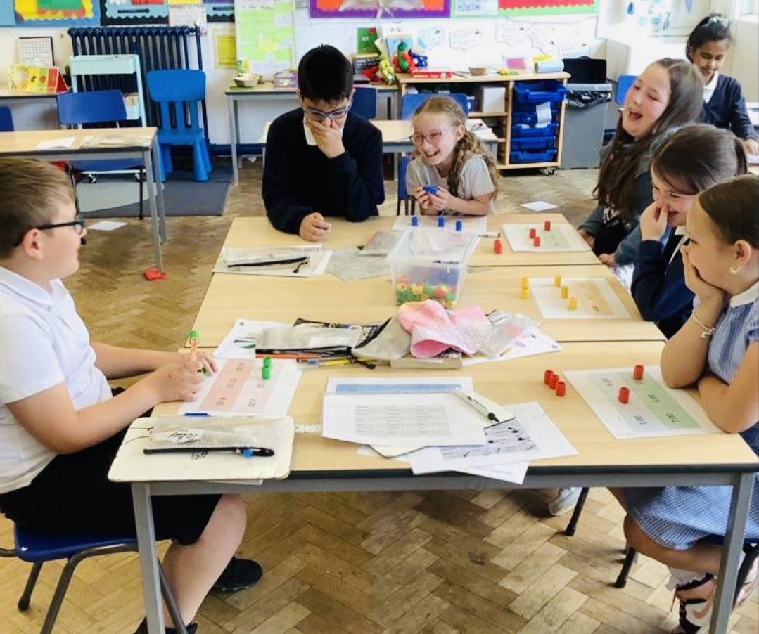
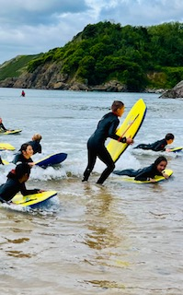
How have practitioners, learners, parents, carers and wider community been engaged to inform the curriculum development?
Our vision for the curriculum at Baden Powell was created with learners, parents and carers and school governors. During school INSET sessions we met to decide what was most important, to and for, our community.
We shared our thoughts with governors and developed a draft vision. This was in turn shared with parents, carers and learners through questionnaires and class sessions. We launched our shared vision through social media, our website and school letters in 2020/21.
It underpins all areas of school life at Baden Powell Primary School.

Slide 5
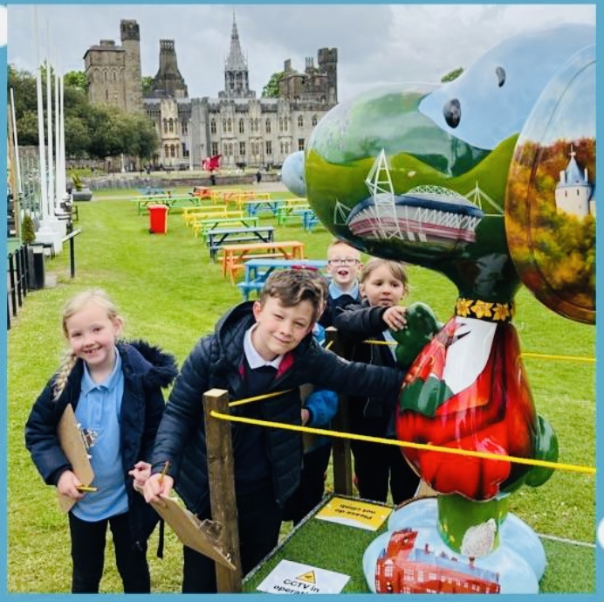
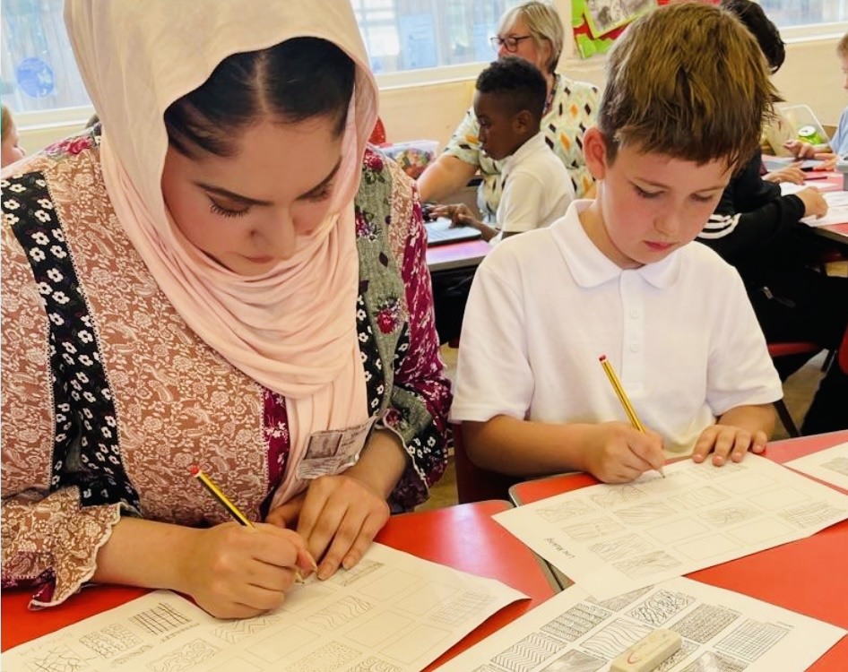
Our school’s curriculum is everything a learner experiences in pursuit of the four purposes. It is not simply what we teach, but how we teach and crucially, why we teach it.
At Baden Powell our curriculum enables us to realise our vision. To design our curriculum:
our school leaders and teachers undertook reading and research and attended professional learning on curriculum
our staff team agreed key features of our school context, learners and community to inform the approaches and experiences best suited for the needs of all at our school and considering the four purposes
governors, staff, parents, carers and learners were asked to consider what all learners should know and be able to do, and which values they should develop during their time at the school
practitioners worked with staff from local schools to support one another in planning our curriculum, ensuring progression
staff worked together to identify the required changes to our current cultures, provision and practices

Slide 6

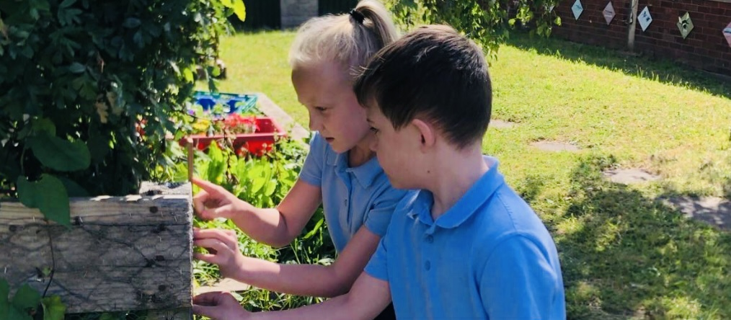
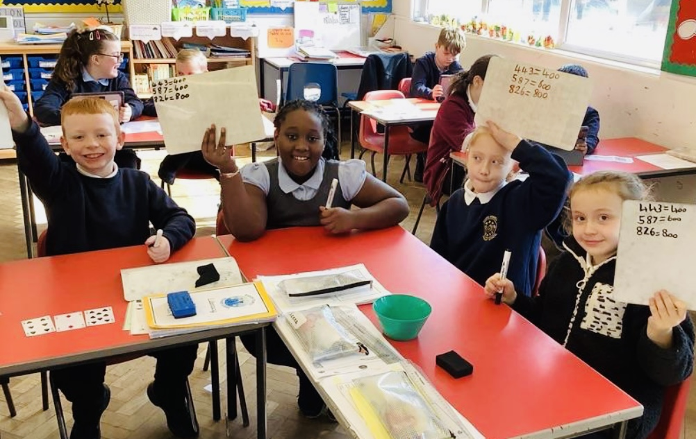
How does the curriculum at Baden Powell meet the required elements of the Curriculum for Wales, starting with the four purposes?
Our school curriculum is suitable for all learners and will enable them to realise the four purposes. It takes account of and responds to the unique opportunities and challenges that present themselves to individuals and groups of learners in our school.
Our school curriculum is broad and balanced and includes learning opportunities within and across all of the Areas of learning and experience. It encompasses the concepts in all of the statements of what matters and provides appropriate progression in accord with the principles of progression.
It also aligns to the mandatory requirements of teaching Welsh, English and Religion, Values and Ethics (RVE). The mandatory elements of Relationship and Sexuality Education (RSE) and the cross curricular skills of literacy, numeracy and digital competence are embedded throughout the curriculum.

Slide 7
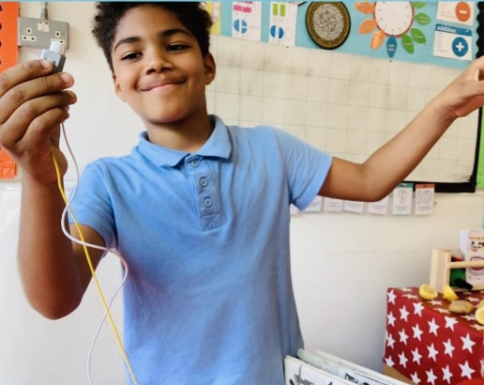
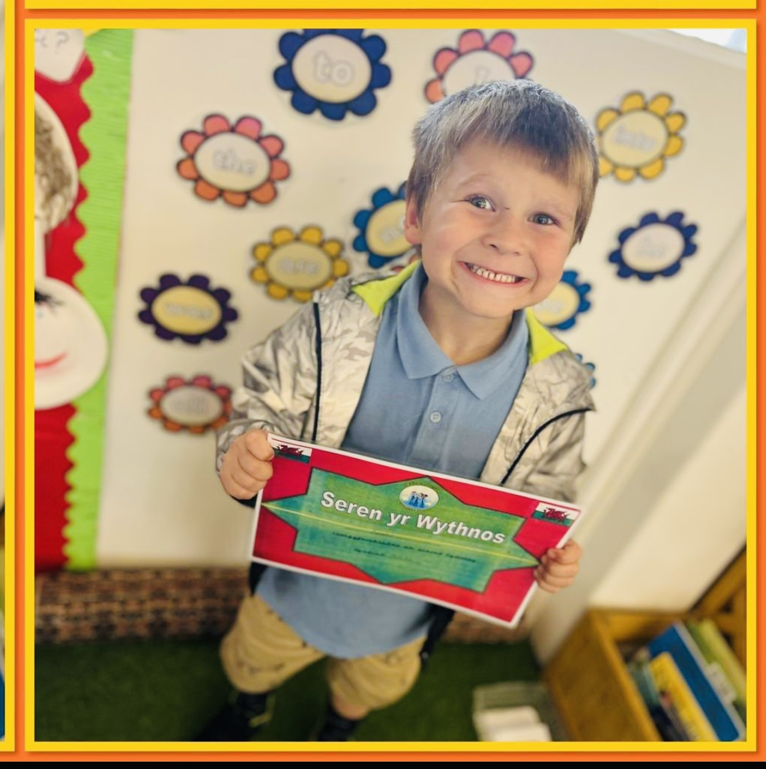
How is Baden Powell approaching learning progression and what are our arrangements for assessment?
Progression and assessment is fundamental to ensuring we achieve our school vision. Our school curriculum is underpinned by the mandatory principles of progression which describe what it means for learners to progress and the capacities and behaviours our staff will seek to support, regardless of a learners’ stage of development.
We use a variety of evidence informed assessment strategies to enable each individual learner to make progress at an appropriate pace.
We ensure our processes identify learners who require further support or challenge and provide rich qualitative intelligence for us to inform next steps in learning for individuals and groups of learners.
Our assessment arrangements ensure active engagement between learners and teachers and is based on ongoing reflection on where a learner is, what their next steps are and what is required to support them in achieving these.

Slide 8
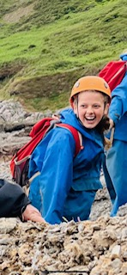
How will the curriculum be kept under review, including the process for feedback and ongoing revision?
At Baden Powell our school curriculum will be kept under review to ensure that it is meeting the needs of our learners and our school vision.
Throughout the year there will be a variety of self-evaluation activities to inform our understanding of the effectiveness of our curriculum and any required revision.
We will work within our school, with the cluster and partner schools, in partnership with governors, the regional consortia, local authority and our ITE partnership, to further develop a shared understanding of progression and to ensure a high-quality 3-16 continuum of learning for all.
Learners will engage in discussions during our themed ideas, giving them a voice in what and how they learn.
The school will share information with parents and carers on the curriculum and ways they can support their child through formal and informal school meetings, Class Dojo posts, our website and social media.
The school will collaborate and consult with a range of providers from the local and wider community on providing learners with distinct and enriching experiences including those related to religion, values and ethics (RVE) and careers and work related experiences (CWRE).

Slide 9
Curriculum for Wales Overview
Curriculum for Wales - 3-16
Pedagogical Principles: Core Purpose Mindset Blended Learning Thinking Building Authentic AfL Connections X-Curricular Learning to Learn Relationships Collaboration | 4 Purposes | Ambitious, capable learners |  |  |  |  |  | Enterprising, creative contributors |  |  |  | Ethical, informed citizens |  |  |  |  | Healthy, confident individuals
 | 6 Areas of Learning & Experience |  | Expressive Arts |  |  |  | Health & Wellbeing |  |  | Humanities |  |  | Languages, Literacy & Communication | Languages, Literacy & Communication | Languages, Literacy & Communication |  | Maths & Numeracy | Numeracy |  | Science & Tech
 | 27 Statements of What Matters – the ‘big ideas’
 | 3 Cross-curricular skills |  |  | Literacy |  |  |  |  | Numeracy | Numeracy |  |  |  |  |  | Digital Competence
 | Progression Steps |  |  |  | Step 1 (Age 5) N/R |  |  | Step 2 (Age 8) Y1/2/3 |  |  | Step 3 (Age 11) Y4/5/6 |  |  |  | Step 4 (Age 14) Y7/8/9 |  |  |  | Step 5 (Age 16) Y10/11
 | Descriptions of Learning – I can…
 | X- themes |  |  | RSE |  | Rights |  | SRE |  | Diversity |  |  |  | Careers |  |  |  | Contexts

Slide 10







 | Areas of Learning and Experience
 | In Expressive Arts, learners will explore art, dance, drama, film and digital media and music to develop their creative, artistic and performance skills.
 | In Humanities they’ll learn about the world, society and events in the past and present. They’ll explore the challenges and opportunities that face us, and what ethical action we can take to safeguard the world and its people in the future.
 | In Mathematics and Numeracy, learners will develop their understanding of numbers and use symbols in maths. They’ll explore shapes and measurement and learn about statistics and probability.
 | Health and Well-being is about looking after their physical and mental health including emotional well-being. They’ll learn about healthy eating and how to make good decisions, deal with influences and develop healthy relationships.
 | In Languages, Literacy and Communication, learners will learn about languages. They’ll understand and use Welsh, English and other languages. They’ll study and create literature, and communicate in spoken, written or visual ways. This could include poetry, drama and film
 | In Science and Technology learners will learn about biology, chemistry, physics, computer science and design and technology. They’ll learn about design and engineering, living things, matter, forces and energy, and how computers work.

Slide 11
Planning for Learning – Core Statements
Whole school - Statements of What Matters
Health & Wellbeing | How we process and respond to our experiences affects our mental health and emotional well-being. | How we engage with social influences shapes who we are and affects our health and well-being.
Humanities | Enquiry, exploration and investigation inspire curiosity about the world, its past, present and future. | Events and human experiences are complex, and are perceived, interpreted and represented in different ways.
Language, Literacy & Communication | Languages connect us. | Understanding languages is key to understanding the world around us. | Expressing ourselves through languages is key to communication. | Literature fires imagination and inspires creativity.
Mathematics & Numeracy | The number system is used to represent and compare relationships between numbers and quantities. | Algebra uses symbol systems to express the structure of mathematical relationships. | Geometry focuses on relationships involving shape, space and position, and measurement focuses on quantifying phenomena in the physical world. | Statistics represent data, probability models chance, and both support informed inferences and decisions.
Science & Tech | Being curious and searching for answers is essential to understanding and predicting phenomena | Design thinking and engineering offer technical and creative ways to meet society’s needs and wants. | Computation is the foundation for our digital world.

Slide 12
Planning for Learning – Themed Statements
Whole school themed approach
Me & my world | Me and the man made world | Me & the natural world
We are explorers ..... | We are investigators ..... | We are carers….
Healthy relationships are fundamental to our well-being. | Matter and the way it behaves defines our universe and shapes our lives. | The world around us is full of living things which depend on each other for survival.
Human societies are complex and diverse, and shaped by human actions and beliefs. | Responding and reflecting, both as artist and audience, is a fundamental part of learning in the expressive arts. | Our decision-making impacts on the Quality of our lives and the lives of others.
Exploring the expressive arts is essential to developing artistic skills and knowledge and it enables learners to become curious and creative individuals. | Forces and energy provide a foundation for understanding our universe. | Informed, self-aware citizens engage with the challenges and opportunities that face humanity, and are able to take considered and ethical action.
Our natural world is diverse and dynamic, influenced by processes and human actions. |  | Creating combines skills and knowledge, drawing on the senses, inspiration and imagination.
Developing physical health and well-being has lifelong benefits.

Slide 13
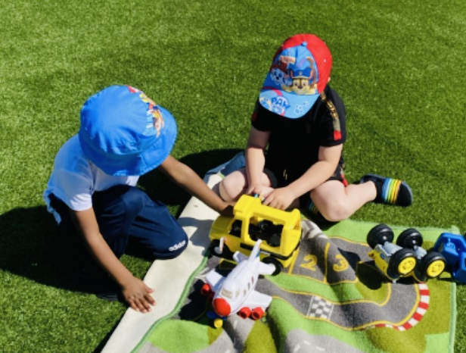
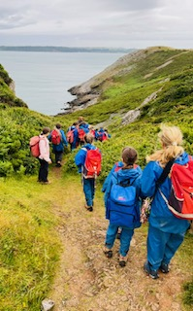
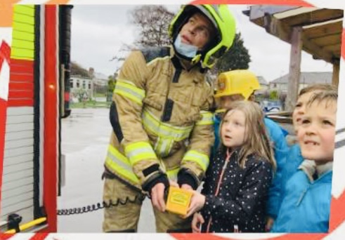
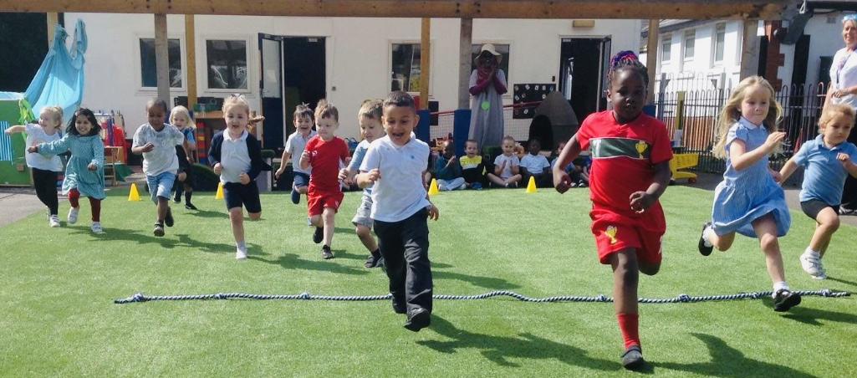
Our Cross Cutting Themes allow learners to develop their understanding of: relationships and sexuality education, human rights education and diversity, careers and work-related experiences, and consider local, national and international contexts.
Relationships & Sexuality Education
RSE in the curriculum focuses on three broad strands:
Relationships and identity: helping learners develop the skills they need to develop healthy, safe, and fulfilling relationships with others and helping them to make sense of their thoughts and feelings.
Sexual health and well-being: helping learners to draw on factual sources regarding their sexual and reproductive health and well-being, allowing them to make informed decisions throughout their lives.
Empowerment, safety and respect: helping to protect learners from all forms of discrimination, violence, abuse and neglect and enabling them to recognise unsafe or harmful relationships and situations, supporting them to recognise when, how and where to seek support and advice.
Human rights
Diversity
Careers and work-related experiences
Local, national and international contexts

Slide 14

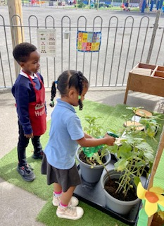
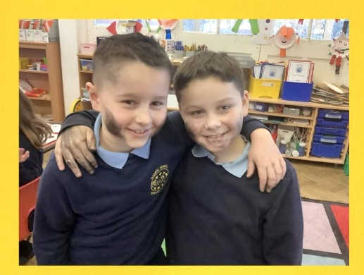
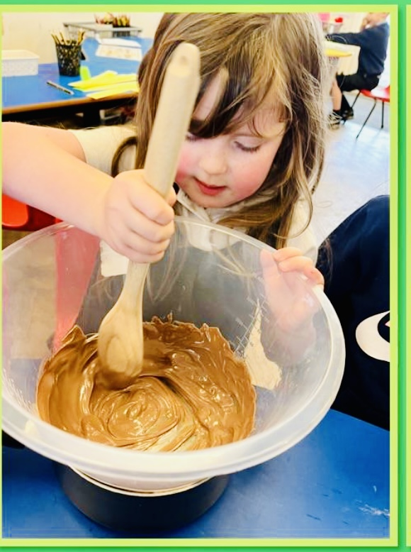
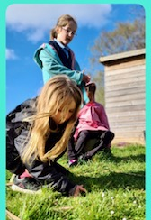
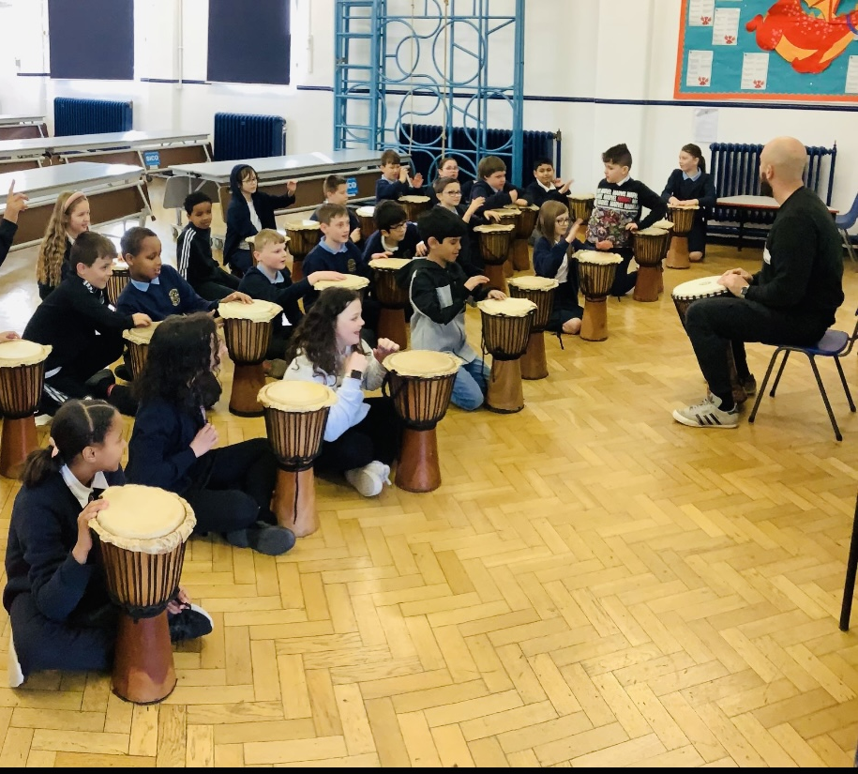
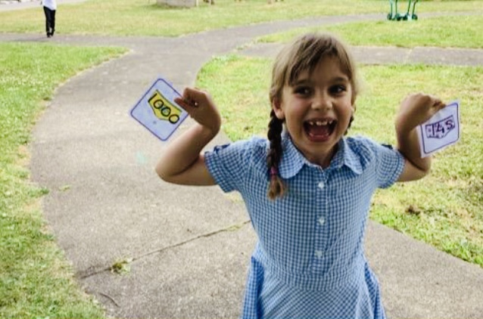
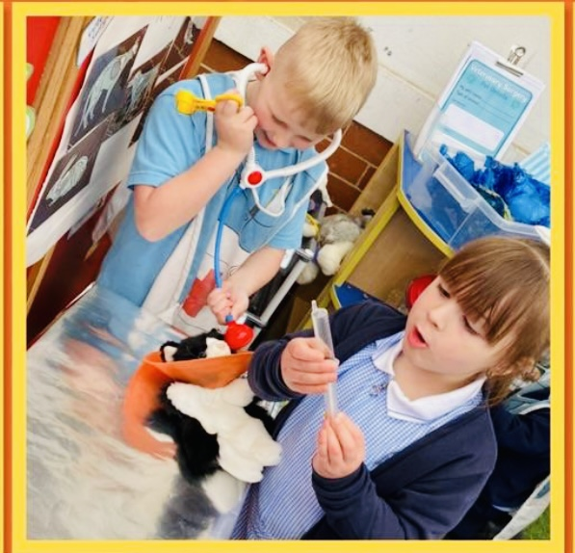
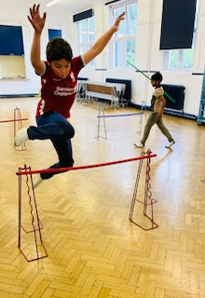
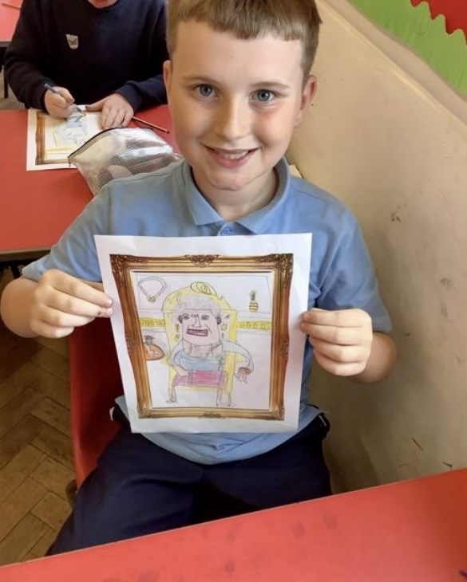
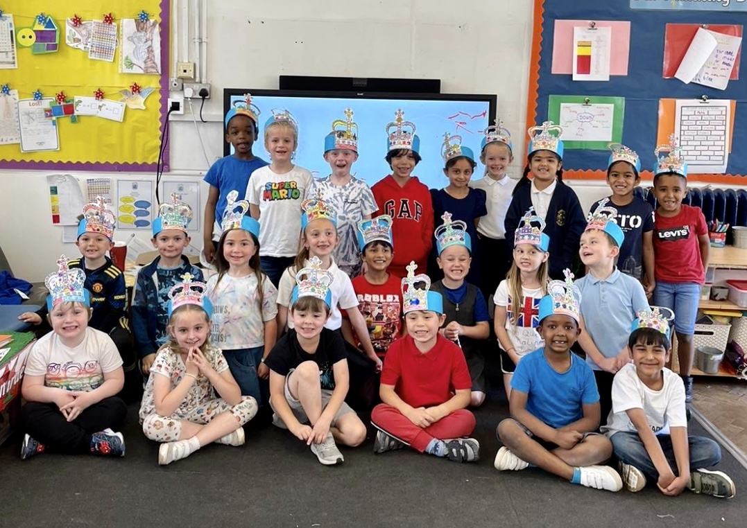
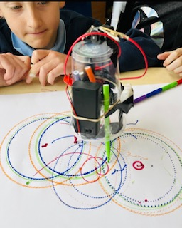
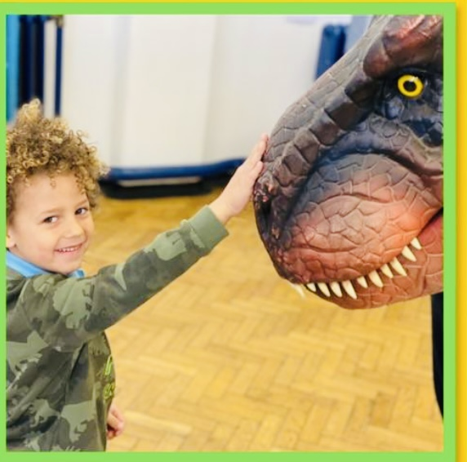
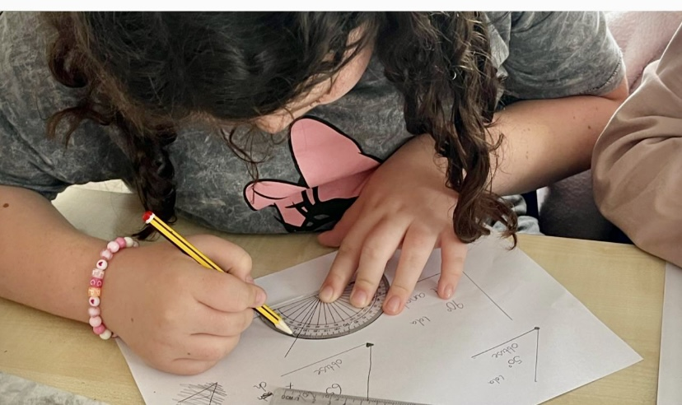
Baden Powell Primary School
Curriculum for Wales
Aim high, Achieve more, Be happy
Adopted by Baden Powell Governing Body: July 2022

Slide 15

Curriculum for Wales
Further Guidance & Support
Curriculum for Wales: https://hwb.gov.wales/curriculum-for-wales
Relationships & Sexuality Education Code- https://gov.wales/sites/default/files/publications/2022-01/curriculum-for-wales-relationships-sexuality-education-code.pdf
Additional Learning Needs Code - https://gov.wales/the-additional-learning-needs-code-and-regulations
Siarter Iaith - https://hwb.gov.wales/siarter-iaith/
Baden Powell Primary School - https://www.badenpowell-cardiff.co.uk/

